Slide 1

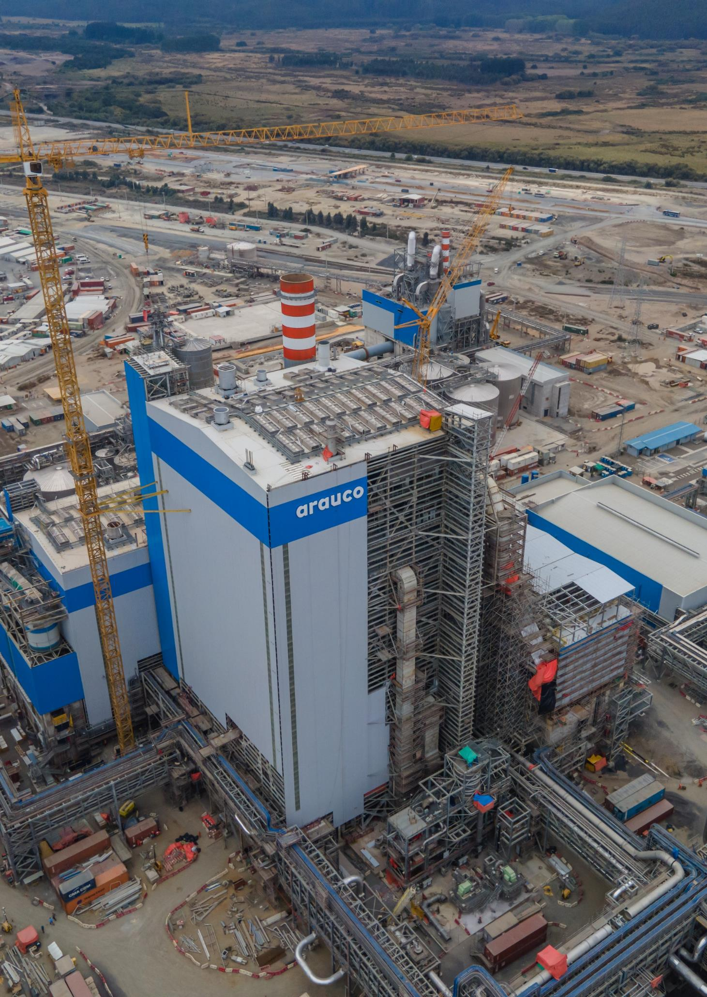
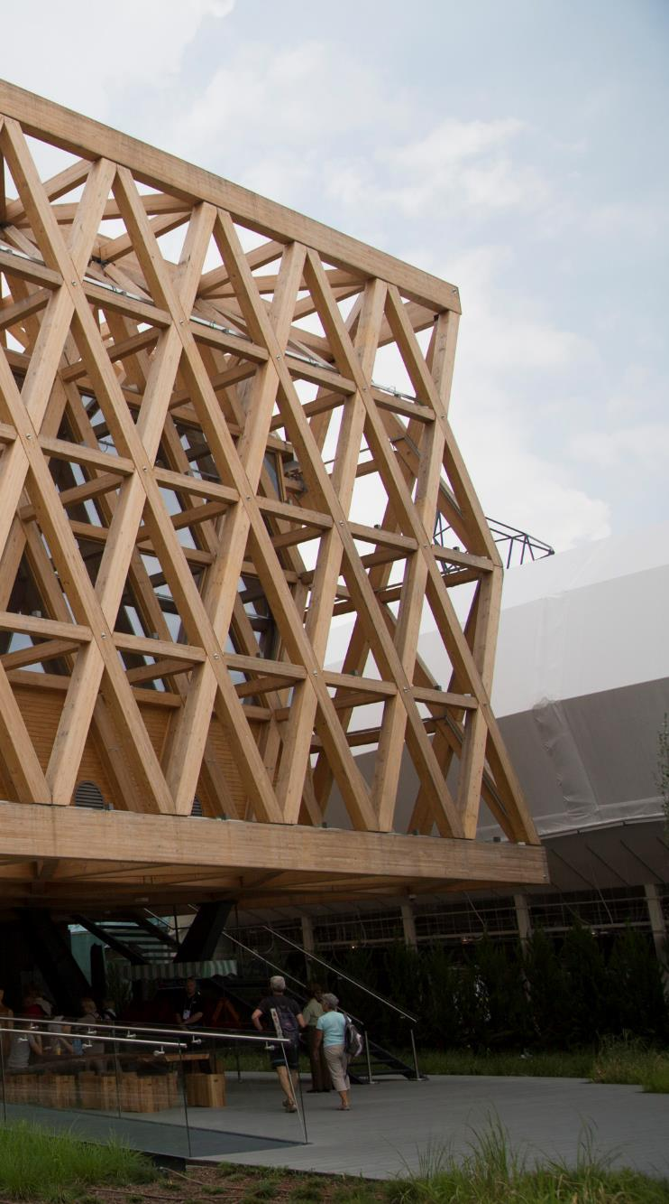
Corporate Presentation
Q2 2022
renewables for a better life

Slide 2

ARAUCO at a glance
As of June 2022
Shareholder Structure
Credit Ratings
Angelini Group
International Scale
National Scale
73.50%
BBB
(Stable)
Fitch Ratings
AA
(Stable)
Fitch Ratings
BBB-
(Stable)
S&P
Antar Chile
AA
(Stable)
Feller Rate
Baa3
(Stable)
Moody’s
60.48%
Empresas Copec
Financial highlights
In US$ million, last twelve months
99.99%
EBITDA 2,789
EBITDA Margin 39%
Net Debt/EBITDA 1.64x
Net Income 1,361
CAPEX 1,682
Revenues 7,076

Slide 3
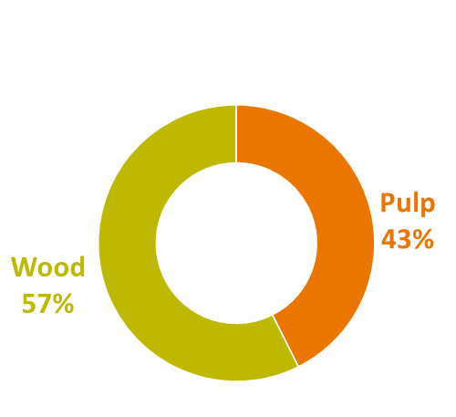
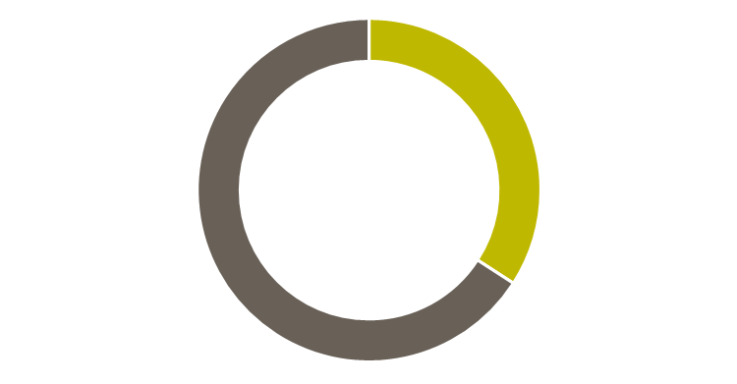

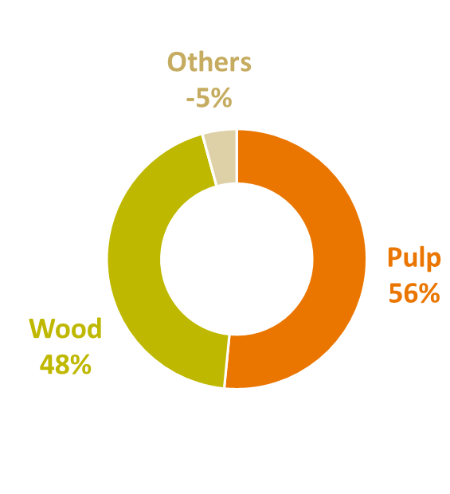
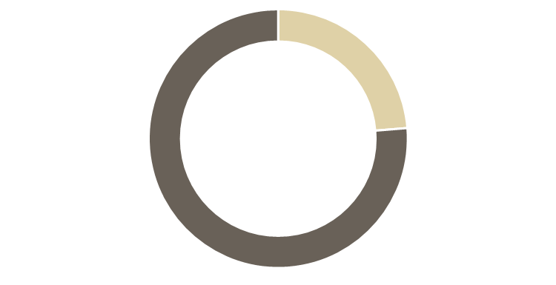
DIVERSIFIED SALES AROUND THE WORLD
REVENUES BY REGION
As of December 2021
Revenues MUS$7,076
32%
North America
30%
Asia and Oceanía
Adjusted EBITDA
MUS$2,789
25%
Central and South America
7%
Europe
5%
Others
As of June 2022 LTM
3
Notes:
Lista

Slide 4
























TWO STRATEGIC BUSINESS SEGMENTS
Pulp
Wood products
Complementary energy operations
Forest Plantations
Mills
Panels
Solid Wood
 | 614 th. Ha ⁽¹⁾ | 5 Mills 2,905 th. t | 2 Mills |  |  | 10 Power Plants 606 MW Surplus: 219 MW
 | 130 th. Ha ⁽¹⁾ | 1 Mill 350 th. t | 2 Mills |  |  | 2 Power Plants 82 MW Surplus: 15 MW
 | 114 th. Ha ⁽¹⁾ |  | 4 Mills
 | 86 th. Ha ⁽¹⁾ ⁽²⁾ | 1 Mill 710 th. t ⁽²⁾ |  |  |  | 1 Power Plant 91 MW ⁽²⁾ Surplus: 50 MW
 |  |  | 8 Mills
 |  |  | 2 Mills
 |  |  | 10 Mills ⁽³⁾⁽⁴⁾
Total | 0.9 million ha | 4.0 million t | 9.0 million m³ | 3.7 million m³ |  | 779 MW
MDF: 500 th. m³
PB: 340 th. m³
7 Sawmills: 2,646 th. m³
Plywood⁽⁵⁾ : 710 th. M³
4 Rem. Facilities
MDF: 300 th. m³
PB: 260 th. m³
1 Sawmill: 318 th. m³
1 Rem. Facility
MDF: 1,520 th. m³
PB: 730 th. m³
MDF: 1,015 th. m³
PB: 1,630 th. m³
MDF: 250 th. m³
PB: 315 th. m³
PB: 1,191 th. m³
MDF: 727 th. m³
OSB: 230 th. m³
1 Sawmill ⁽³⁾: 35 th. m³
As of December 2021
Considers hectares planted mainly with eucalyptus (globulus, nitens), pine (radiata, taeda, elliottii) and others.
Considers 50% of Montes del Plata
Considers 50% of Sonae Arauco
One PB mill in South Africa is currently shut down
Considers 2 plywood mills.
4

Slide 5
WE ARE A MAIN PLAYER IN THE GLOBAL MARKET
Market Pulp Capacity (thousand tonnes)
5,235
#2
In market pulp capacity in the world
MAPA’s net capacity increase
World Panels** Capacity (thousand m³)
#2
In panels capacity in the world
9,087
World market pulp and panel competitors capacity as of December 2021
*Arauco capacity includes 50% of Montes del Plata, 50% Sonae Arauco, and MAPA Project, as of December 2020
**Panels refers to Composite Panels, which corresponds to MDF, PB and OSB.
Source: Hawkins Wright, Public fillings, Arauco estimations and Company information and fillings
4

Slide 6
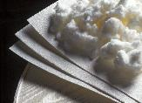
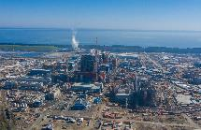
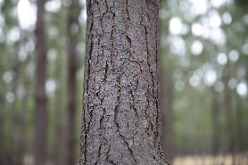
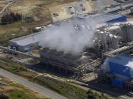
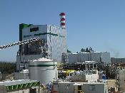

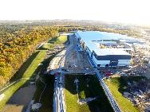
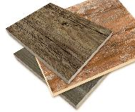
MAXIMIZING THE VALUE OF OUR FORESTS
PULP
EKP
BSKP
UKP
Fluff
Dissolving Pulp
Pine & Eucalyptus
PULP
MILLS
Bark & Waste
SURPLUS
Chips
Black Liquor
277 MW
HEAT PRODUCTION
ENERGY
& STEAM
National Grid
Bark & Waste
Pine
MDF / PB
Plywood Sawn Timber
Rem. Wood Products
WOOD PRODUCTS MILLS
WOOD PRODUCTS
6

Slide 7
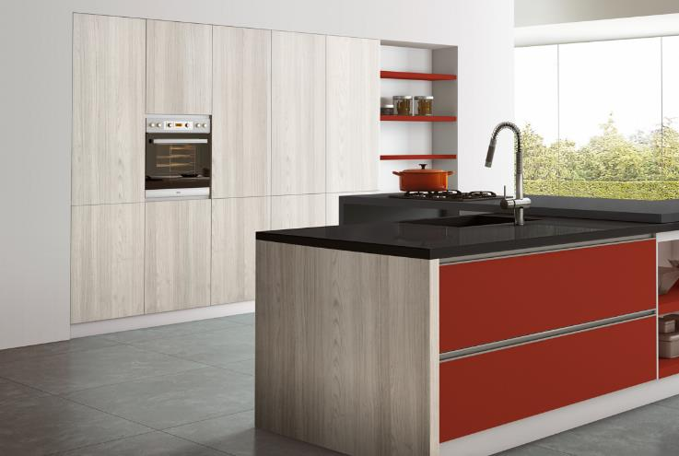
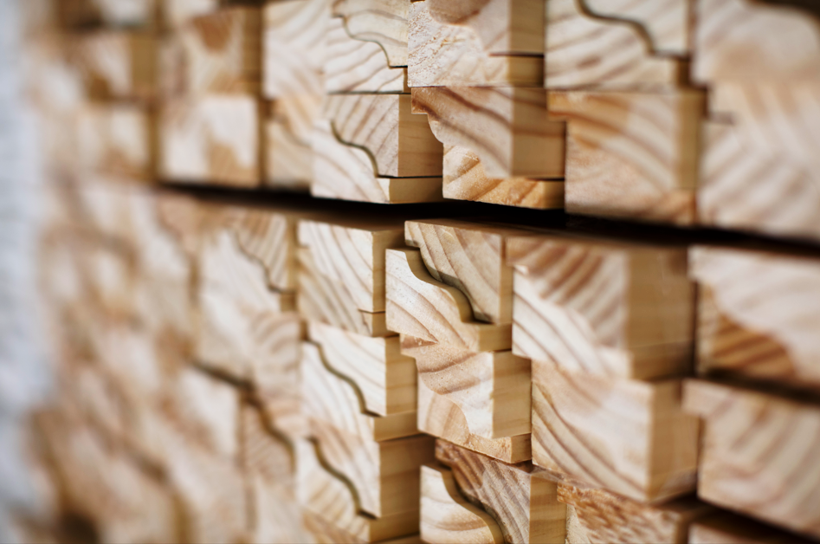
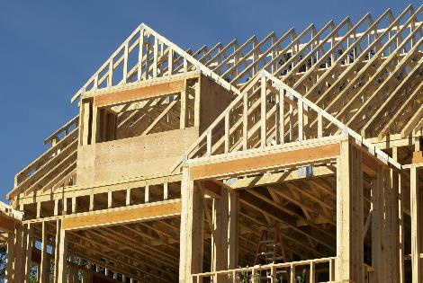
BUSINESS
SEGMENTS

Slide 8
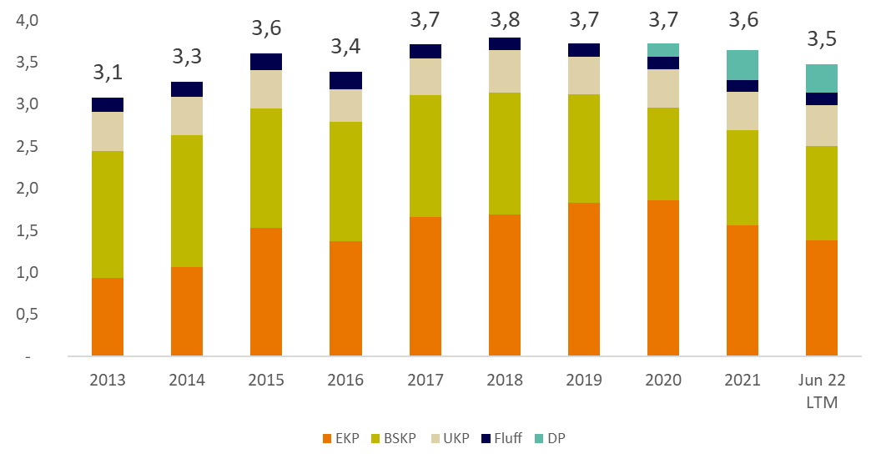
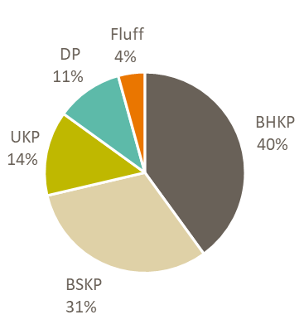
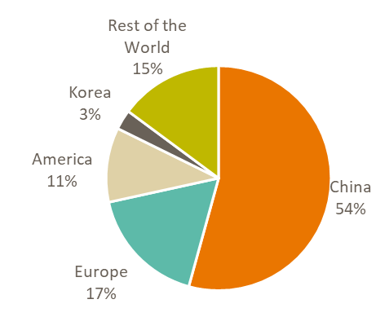


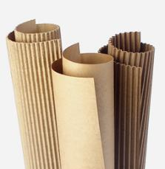
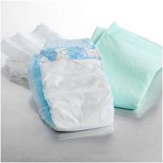

PULP BUSINESS
Production
million tonnes
Pulp Sales
MUS$2,910
Does not include energy sales
As of June 2022 LTM
Sales volume: 3.5 million tonnes
EKP ⁽¹⁾ BSKP ⁽²⁾ UKP ⁽³⁾ FLUFF DP ⁽⁴⁾
Eucalyptus Kraft Pulp
Bleached Softwood Kraft Pulp
Unbleached Kraft Pulp
Dissolving Pulp
As of June 2022 LTM
8
Notes:
Sales amount is from ingresos Ing. Ordinarios since it does not include energy

Slide 9
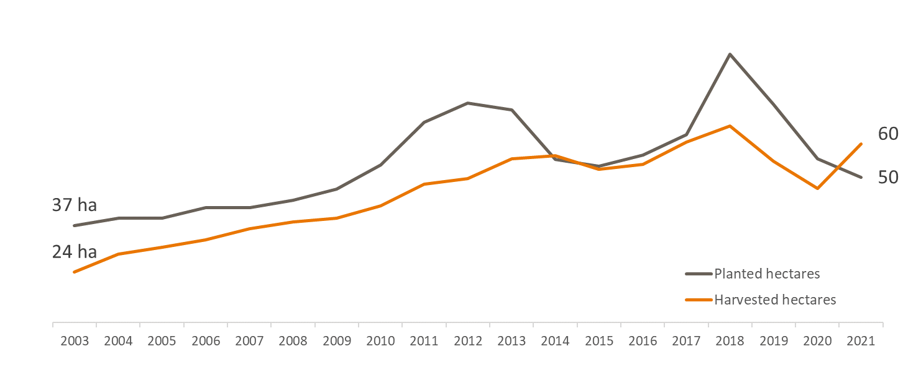
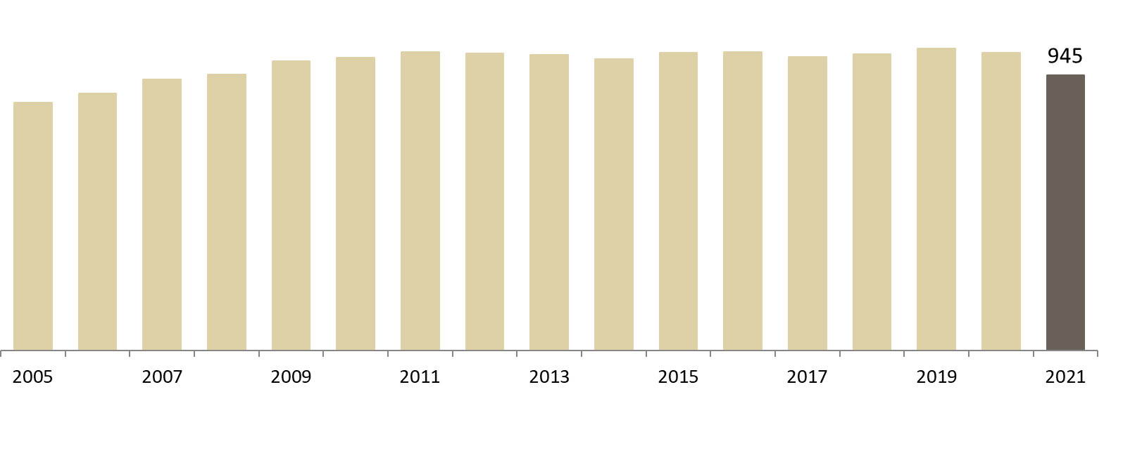




PULP BUSINESS – FORESTRY OPERATIONS
Total Plantations
Includes plantations in Chile, Argentina, Brazil and Uruguay
Planting and harvesting
In thousand hectares
In thousand hectares
1.6 million (*)
Hectares Planted
Environmental Certifications
Our forests plantations have international certification in Forestry Management and Chain of Custody
For detailed information about each certification, you can visit our web site www.arauco.com
hectares owned
Pine : 53 th. Euca: 61 th.
Others: 0.2 th.
945 thousand
114 th.
hectares planted
Euca: 86 th.
Pine: 0.2 th.
Others: 0.3 th.
643 th. of Pine
Pine : 429 th. Euca: 183 th.
Others: 2 th.
86 th.
356 th. of Euca
Pine : 92 th. Euca: 19 th.
Others: 20 th.
22 th. Others
614 th.
130 th.
(*) includes 483 th. hectares of native forest plantations.
As of December 2021
9

Slide 10
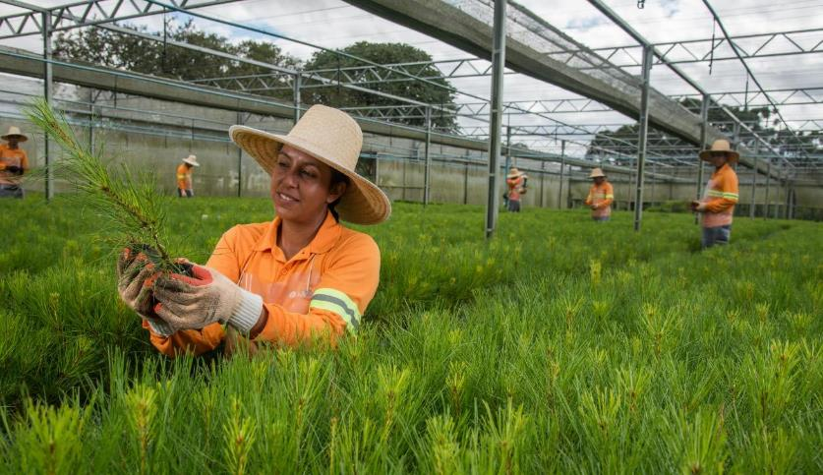
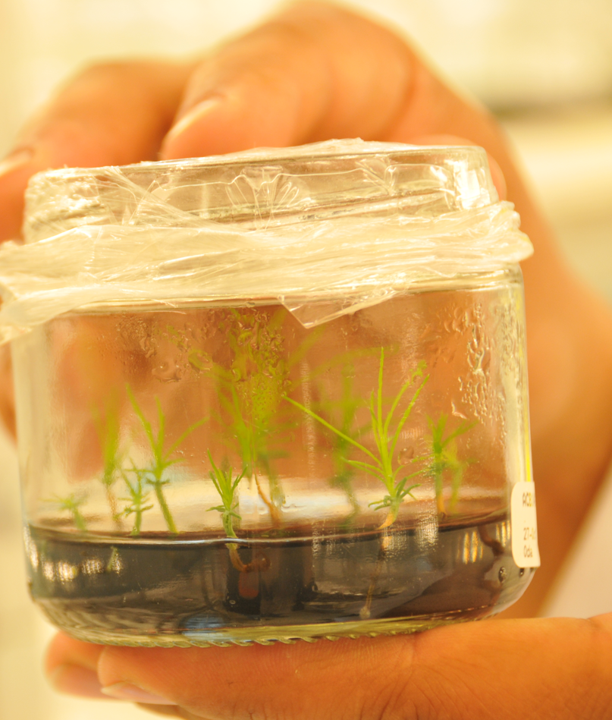
PULP BUSINESS – FORESTRY OPERATIONS
Bioforest research and development
Bioforest was formed in 1990 by Arauco and one of the achievements has been the increase in the plantation yields by 40%
50+
Researchers
Bioforest has a wide participation in local and international organizations that are leaders in the forestry-industrial scientific knowledge
work in order to develop and apply the best technologies, maximizing the forestry and industrial resources.
In addition, Bioforest aims to fulfill the environmental objectives for the protection and conservation of biodiversity present in our native forests
10
Notes:
Listo (marcelo)

Slide 11
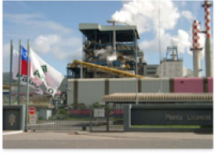
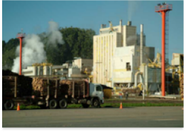

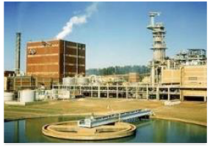
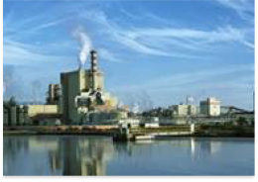

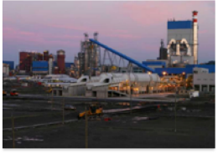
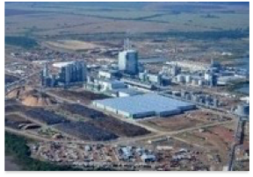
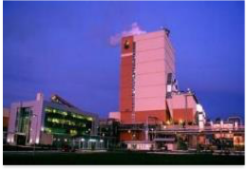
PULP BUSINESS
OUR MILLS
in thousand tonnes
As of December 2021
LICANCEL
160 UKP
CONSTITUCION
355 UKP
ESPERANZA
350 BSKP & Fluff Swing mill
MAPA PROJECT (2022)
NEW LINE 3
1,560 EKP
ARAUCO MILL
LINE 2: 510 BSKP
NUEVA ALDEA 520 EKP
520 BSKP
MONTES DEL PLATA 1,414 EKP
Arauco owns 50%
VALDIVIA
550 EKP, or DP Swing mill
11
Notes:
Listo (marcelo)

Slide 12
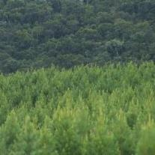
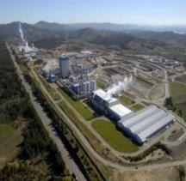
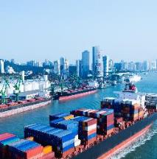
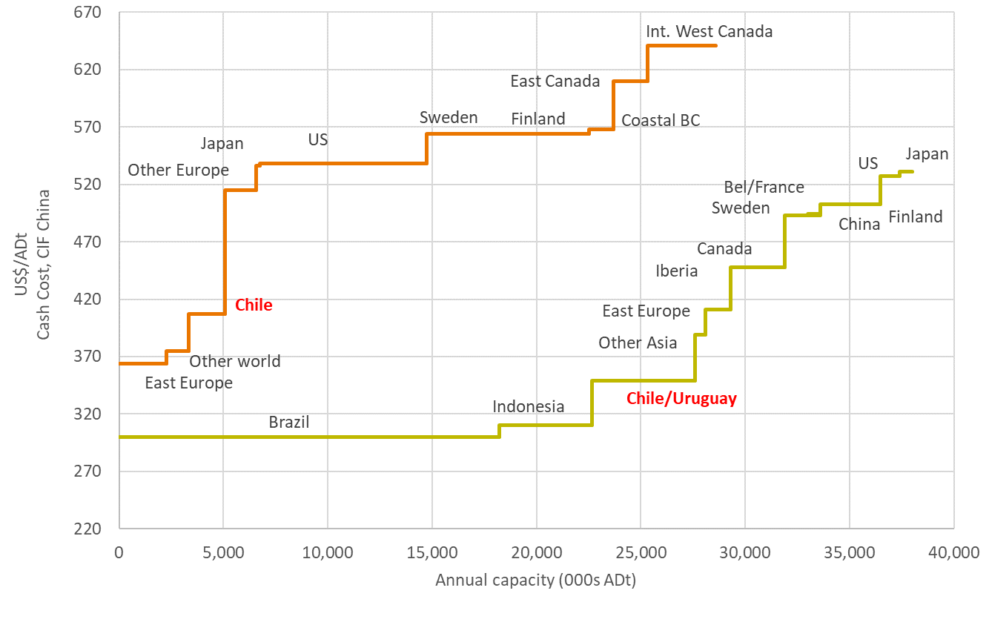
PULP BUSINESS
COMPETITIVE ADVANTAGES
1. Logistic Efficiency
2. Cost Advantages
Average distances from
Forests to Mills
Average distances from
Mills to Ports
Km
Chile
85
Licancel
420
Argentina
80
Constitucion
316
Nueva Aldea
63
Uruguay
282
Arauco
35
Valdivia
301
Arauco
Alto Paraná
1,200
Montes del plata
0
BSKP
BHKP
Weighted Avg.
149⁽²⁾
Source: Hawkins Wright, as of December 2021
Other world includes Argentina, China and Oceania.
195 ⁽¹⁾
with MAPA
Source: ARAUCO, as of December 2021
(1) Calculated using sales volume for 2021
(2) Calculated including sales volume from ARAUCO´s Line 3 expected capacity
12

Slide 13
PULP BUSINESS
COMPETITIVE ADVANTAGES
3. Product Diversification
BCP shipment by end-use, 2022 estimate ⁽²⁾
(23%)
HARDWOOD
Current Capacity
4.0 million tonnes
(77%)
SOFTWOOD
(16%)
HARDWOOD
Projected Capacity
5.2 million tonnes
Including MAPA’s added capacity
(84%)
SOFTWOOD
(2) Source: Hawkins Wright, as of December 2021
BCP: Bleached Chemical Pulp, which includes all bleached kraft pulp (and not unbleached) and sulphite pulp
Source: ARAUCO, as of December 2021
(1) Dissolving Pulp
The Valdivia mill will keep the ability to switch from producing dissolving pulp to paper grade (EKP).
13

Slide 14
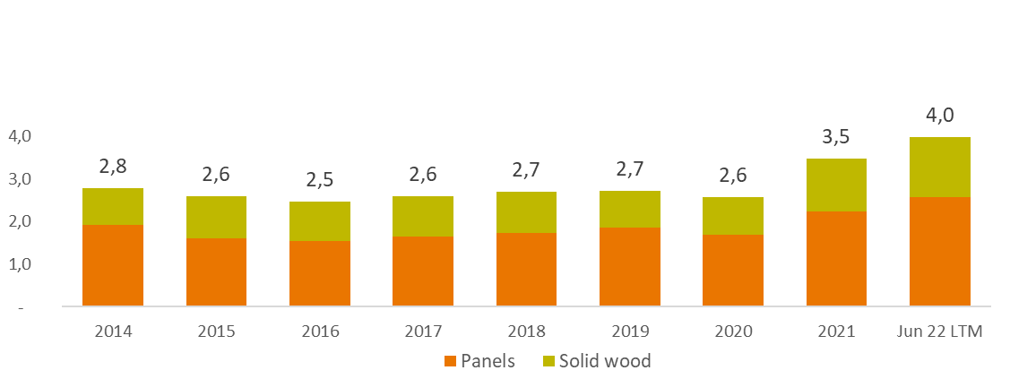
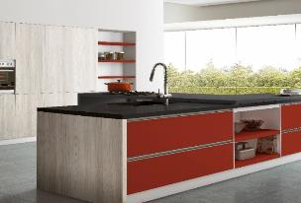
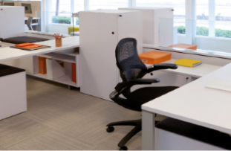

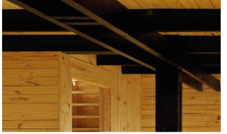
WOOD PRODUCTS BUSINESS
Sales evolution
US$ billion
Revenues
MUS$4,000
Does not include energy sales
As of June 2022 LTM
Subdivisions
PANELS
SOLID WOOD
14

Slide 15
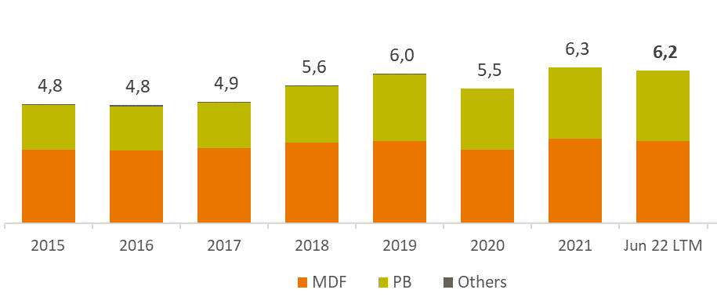
WOOD PRODUCTS BUSINESS: PANELS
Production
million m³
Panels Sales
MUS$2,576
Does not include energy sales
As of June 2022 LTM
Sales volume: 5.9 million m³
As of June 2022 LTM
Does not include Sonae Arauco volumes
*OSB, HB, Retail and Composite panels
** EMEA, Asia, Oceania and Rest of Latam
15
Notes:
Agregar Mexico e production y sales volume

Slide 16
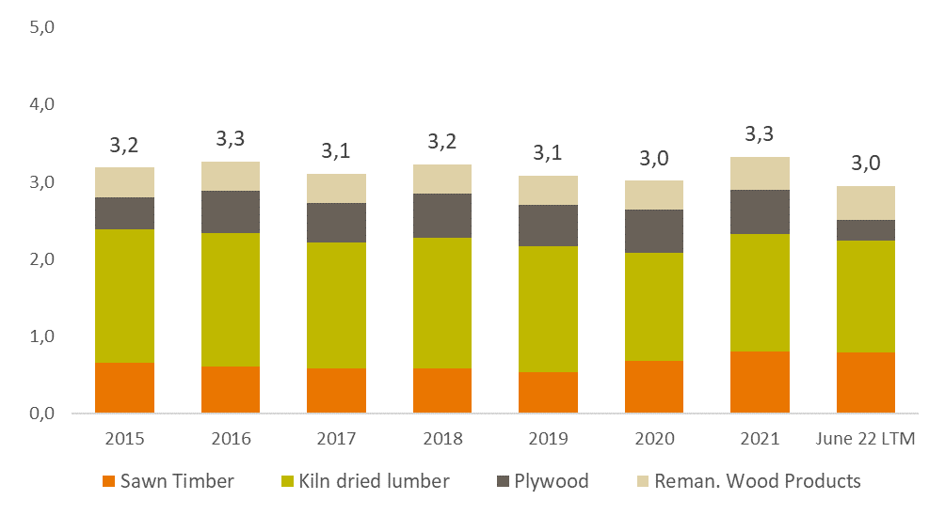
WOOD PRODUCTS BUSINESS: SOLID WOOD
Production
million m³
Solid Wood Sales
MUS$1,424
Sales volume: 2.8 million m³
Does not include energy sales
As of June 2022 LTM
As of June 2022, LTM
Does not include Sonae Arauco volumes
* Pallets
17
Notes:
Listo

Slide 17







PANELS
OUR MILLS
in thousands
2 mills
420 m³ MDF
4 mills *
1,050 m³ PB
884 m³ MDF
460 m³ OSB
2 mills*
140 m³ MDF
430 m³ PB
2 mills*
360 MDF
450 PB
6 mills
595 m³ MDF
1,630 m³ PB
2 mills
315 m³ PB
250 m³ MDF
4 mills
1,520 m³ MDF
730 m³ PB
2 mills*
452 m³ PB**
70 m³ MDF
3 mills
500 m³ MDF
340 m³ PB
Legend
MDF: Medium Density Fiberboard PB: Particle Board
OSB: Oriented Strand Board
2 mills
300 m³ MDF
260 m³ PB
As of December 2021
*Arauco owns 50% of Sonae Arauco
**One PB mill in South Africa is currently shut down
16

Slide 18
SOLID WOOD
OUR MILLS
in thousands
1 sawmill*
70 th. m³ ST
7 Sawmills
2,646 m³ ST
408 m³ Rem
2 Plywood Mills
710 m³
Legend
ST: Sawn Timber
Rem: Remanufactured Wood Products
1 sawmill
318 m³ ST
67 m³ Rem
As of December 2021
*Arauco owns 50% of Sonae Arauco
18

Slide 19





ENERGY COMPLEMENTARY OPERATIONS
Highlights
As of September 2018
Arauco generates renewable energy from forestry biomass and uses it in the production processes.
In Chile, Argentina and Uruguay, we are self-sufficient in net electricity consumption and we sell the surplus to the local grid.
Revenues
5 cogeneration plants in Chile and 1 plant in Uruguay are registered under the Kyoto Protocol Clean Development Mechanism (CDM).
We expect MAPA will generate an additional surplus of 142MW available for the national grid.
MUS$93
As of June 2022 LTM
779 MW
Installed capacity
277 MW
Sold to National Grid in Chile, Argentina and Uruguay
606 MW
82 MW
900,000 homes
can be powered by the surplus injected to the grid
91 MW
19
Notes:
Listo

Slide 20
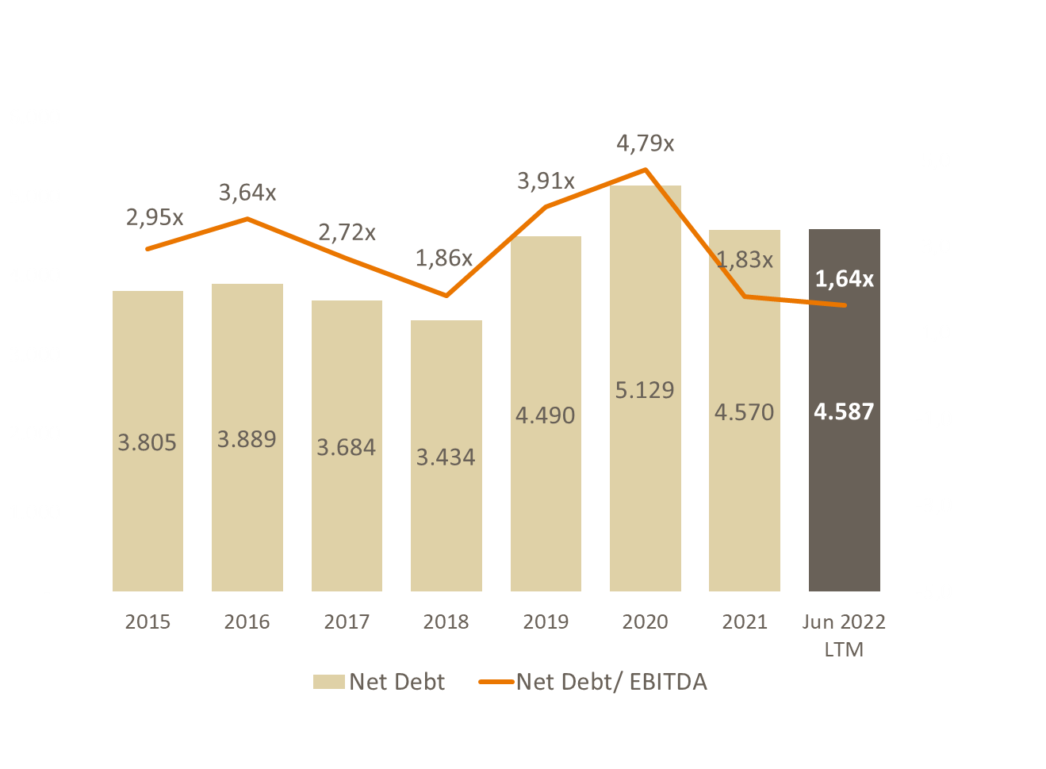
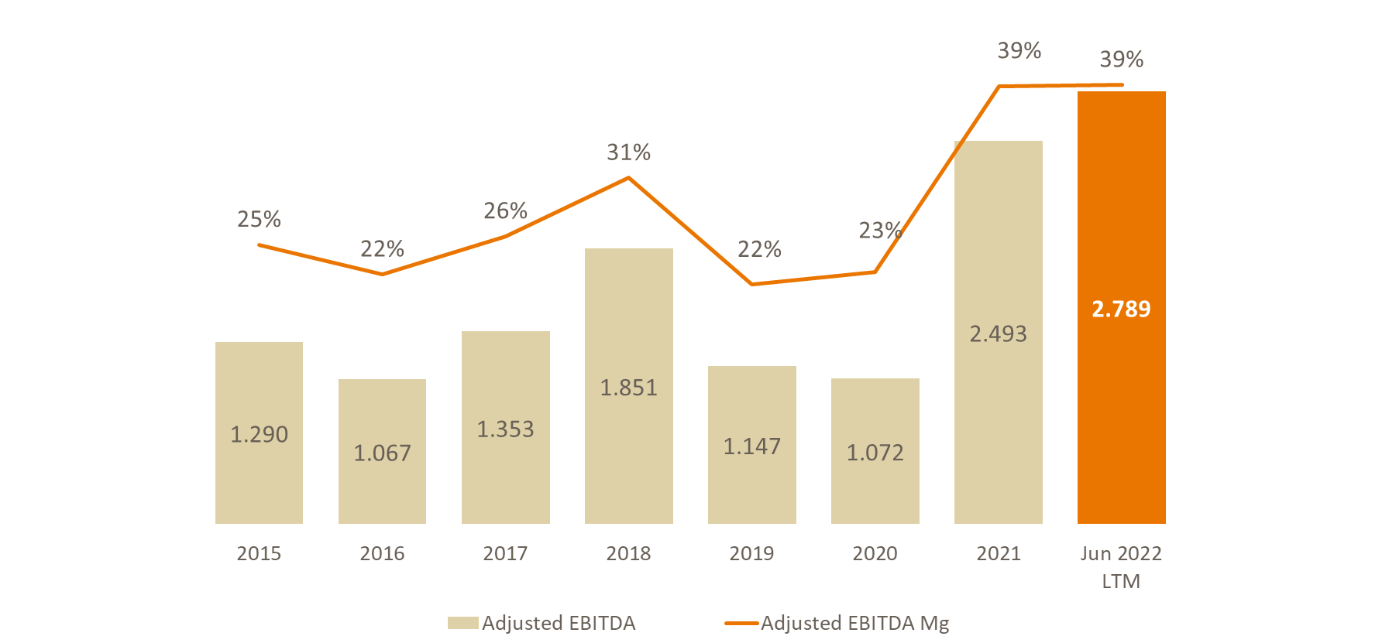
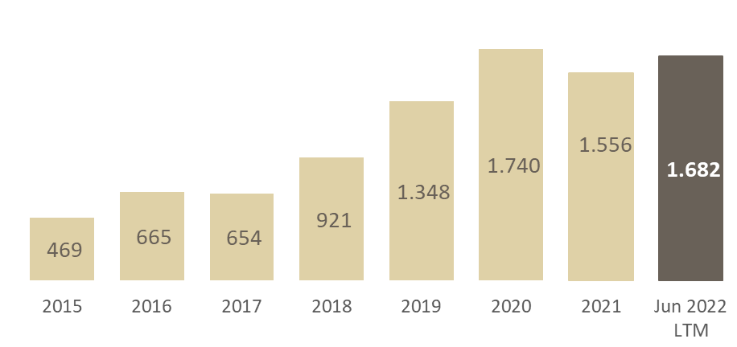
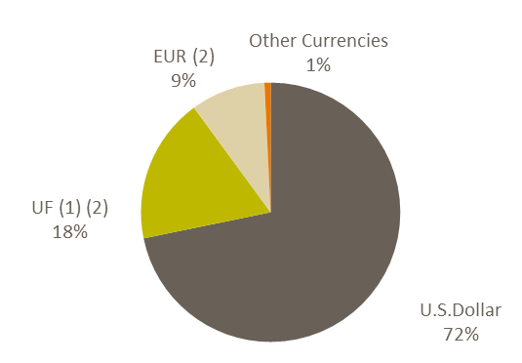
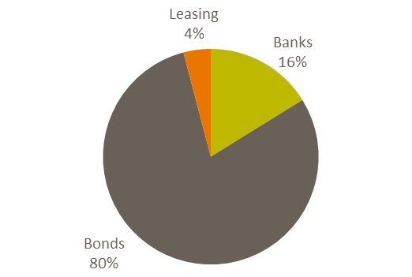
MAIN FIGURES
Adjusted EBITDA
Net Debt
US$ million
US$ million
CAPEX
Debt Breakdown
US$ million
by Instrument
by Currency
As of June 2022
(1) UF is a Chilean monetary unit indexed to inflation.
(2) Swapped to USD
20
Notes:
Lista

Slide 21
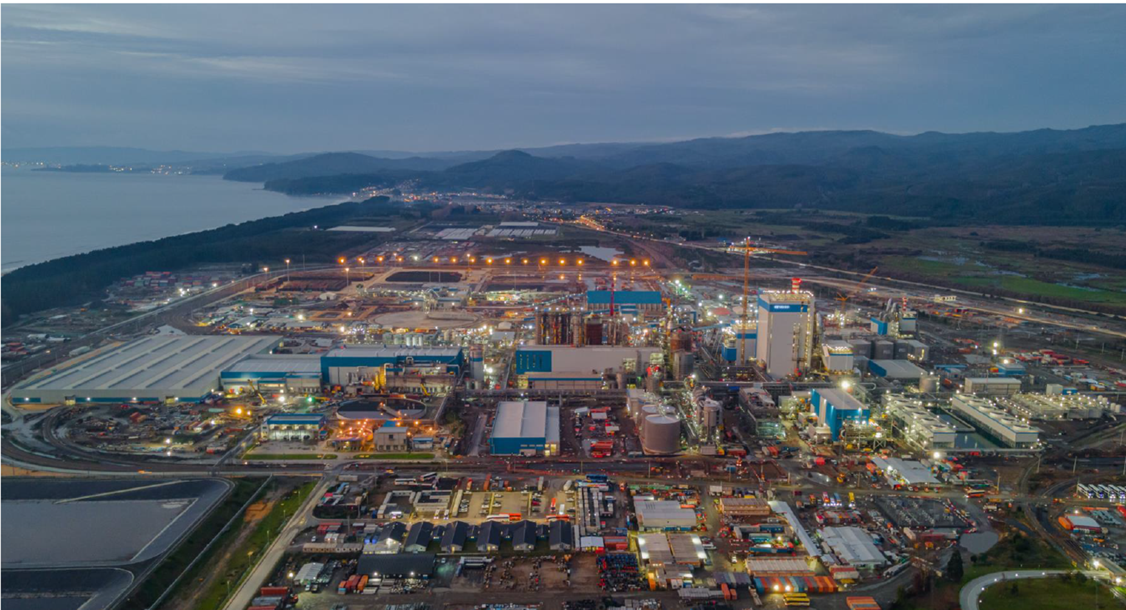
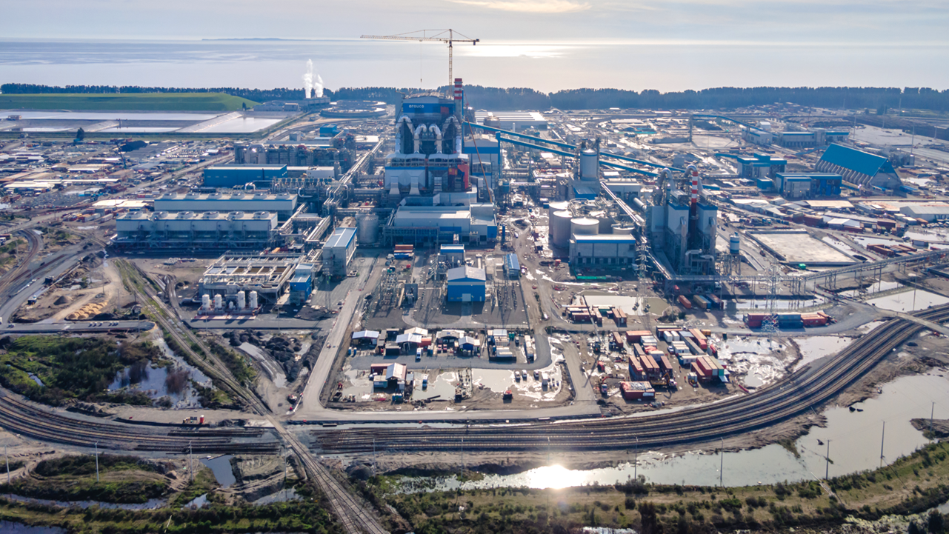
MAPA NEW PULP LINE AT ARAUCO MILL & COGENERATION PLANT
Modernization and Expansion of the Arauco Mill (MAPA) consists in the construction of a third pulp line of 1.56 million tonnes of short fiber production capacity.
We currently estimate the investment for this project to be of approximately US$ 2.8 billion.
Production of first bale is estimated for the end of October
increasing ARAUCO’s total yearly pulp production capacity to more than 5 million tonnes.
The Project also considers the shut down of Arauco´s line 1 of 290 th. tonnes of short fiber pulp (done on January 3rd 2022), and the construction of a cogeneration plant that we expect will generate a surplus of 142 MW to be made available for the national grid.
21

Slide 22

SUSTAINABILITY STRATEGY
Deloitte officially validated our carbon neutrality for 2018, 2019 and 2020 (Method applied in accordance with the Deloitte Neutrality Protocol guidelines). On 2019, we generated a net surplus of 13,053,590 tons of CO2e captured.
Price Waterhouse Coopers audited the entire estimation process of captures and storage in forestry products.
ARAUCO was the first company to successfully apply this protocol.
The goal is to be able to expand the use of this protocol which may be applied to other firms and industries.
22
Notes:
Agregar Mexico e production y sales volume

Slide 23
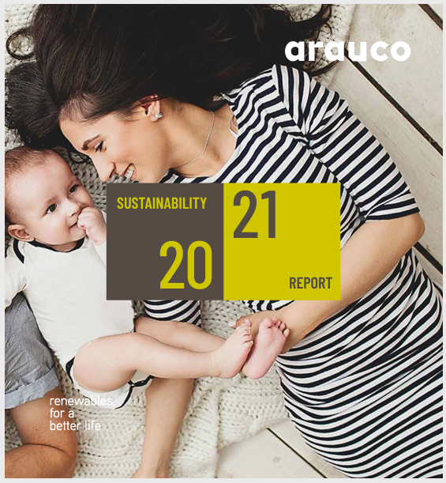


Slide 24

FOR FURTHER INFORMATION, PLEASE CONTACT:
Marcelo Bennett, Treasurer
marcelo.bennett@arauco.com
Phone: (562) 2461 7309
Constanza Vásquez, Investor Relations constanza.vasquez@arauco.com
Phone: (562) 2461 7434
investor_relations@arauco.com
For further information, please visit www.arauco.com

